Slide 1
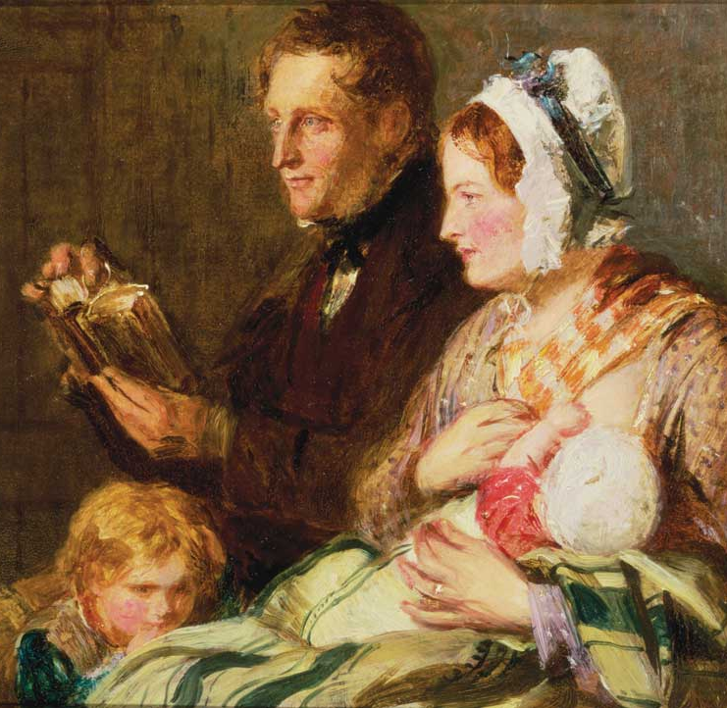
Marriage
Cultural Engagement

Slide 2
What does the culture say about marriage?
“Marriage is, more than anything else, an expression of love.” —Gregg Easterbrook, The New Republic
“[Marriage is] a sacred bond [in which] two people make an exclusive commitment to one another.” —David Brooks, The New York Times
“[Marriage is] a commitment to live up to the rigorous demands of love, to care for each other as best as you humanly can.” —E.J. Graff, What Is Marriage For?

Slide 3
What does the Bible say about marriage?
So God created man in his own image, in the image of God he created him; male and female he created them. And God blessed them. And God said to them, “Be fruitful and multiply and fill the earth and subdue it, and have dominion over the fish of the sea and over the birds of the heavens and over every living thing that moves on the earth.” (Genesis 1:27-28)

Slide 4
Then the LORD God said, “It is not good that the man should be alone; I will make him a helper fit for him.” Now out of the ground the LORD God had formed every beast of the field and every bird of the heavens and brought them to the man to see what he would call them. And whatever the man called every living creature, that was its name. The man gave names to all livestock and to the birds of the heavens and to every beast of the field. But for Adam there was not found a helper fit for him. So the LORD God caused a deep sleep to fall upon the man, and while he slept took one of his ribs and closed up its place with flesh. And the rib that the LORD God had taken from the man he made into a woman and brought her to the man. Then the man said, “This at last is bone of my bones and flesh of my flesh; she shall be called Woman, because she was taken out of Man.” Therefore a man shall leave his father and his mother and hold fast to his wife, and they shall become one flesh. (Genesis 2:18-24)

Slide 5
You cover the LORD’s altar with tears, with weeping and groaning because he no longer regards the offering or accepts it with favor from your hand. But you say, “Why does he not?” Because the LORD was witness between you and the wife of your youth, to whom you have been faithless, though she is your companion and your wife by covenant. Did he not make them one, with a portion of the Spirit in their union? And what was the one God seeking? Godly offspring. So guard yourselves in your spirit, and let none of you be faithless to the wife of your youth. “For the man who does not love his wife but divorces her, says the LORD, the God of Israel, covers his garment with violence, says the LORD of hosts. So guard yourselves in your spirit, and do not be faithless.” (Malachi 2:13-16)

Slide 6
And Pharisees came up to [Jesus] and tested him by asking, “Is it lawful to divorce one’s wife for any cause?” He answered, “Have you not read that he who created them from the beginning made them male and female, and said, ‘Therefore a man shall leave his father and his mother and hold fast to his wife, and the two shall become one flesh’? So they are no longer two but one flesh. What therefore God has joined together, let not man separate.” They said to him, “Why then did Moses command one to give a certificate of divorce and to send her away?” He said to them, “Because of your hardness of heart Moses allowed you to divorce your wives, but from the beginning it was not so. And I say to you: whoever divorces his wife, except for sexual immorality, and marries another, commits adultery.” The disciples said to him, “If such is the case of a man with his wife, it is better not to marry.” But he said to them, “Not everyone can receive this saying, but only those to whom it is given. For there are eunuchs who have been so from birth, and there are eunuchs who have been made eunuchs by men, and there are eunuchs who have made themselves eunuchs for the sake of the kingdom of heaven. Let the one who is able to receive this receive it.” (Matthew 19:3-12)

Slide 7
The same day Sadducees came to him, who say that there is no resurrection, and they asked him a question, saying, “Teacher, Moses said, ‘If a man dies having no children, his brother must marry the widow and raise up offspring for his brother.’ Now there were seven brothers among us. The first married and died, and having no offspring left his wife to his brother. So too the second and third, down to the seventh. After them all, the woman died. In the resurrection, therefore, of the seven, whose wife will she be? For they all had her.” But Jesus answered them, “You are wrong, because you know neither the Scriptures nor the power of God. For in the resurrection they neither marry nor are given in marriage, but are like angels in heaven. (Matthew 22:23-30)

Slide 8
Wives, submit to your own husbands, as to the Lord. For the husband is the head of the wife even as Christ is the head of the church, his body, and is himself its Savior. Now as the church submits to Christ, so also wives should submit in everything to their husbands. Husbands, love your wives, as Christ loved the church and gave himself up for her, that he might sanctify her, having cleansed her by the washing of water with the word, so that he might present the church to himself in splendor, without spot or wrinkle or any such thing, that she might be holy and without blemish. In the same way husbands should love their wives as their own bodies. He who loves his wife loves himself. For no one ever hated his own flesh, but nourishes and cherishes it, just as Christ does the church, because we are members of his body. “Therefore a man shall leave his father and mother and hold fast to his wife, and the two shall become one flesh.” This mystery is profound, and I am saying that it refers to Christ and the church. However, let each one of you love his wife as himself, and let the wife see that she respects her husband. (Ephesians 5:22-33)

Slide 9
Then I heard what seemed to be the voice of a great multitude, like the roar of many waters and like the sound of mighty peals of thunder, crying out, “Hallelujah! For the Lord our God the Almighty reigns. Let us rejoice and exult and give him the glory, for the marriage of the Lamb has come, and his Bride has made herself ready; it was granted her to clothe herself with fine linen, bright and pure”—for the fine linen is the righteous deeds of the saints. And the angel said to me, “Write this: Blessed are those who are invited to the marriage supper of the Lamb.” And he said to me, “These are the true words of God.” (Revelation 19:6-9)

Slide 10
What does the Bible say about marriage?
A covenantal bond between one man and one woman
Exclusive and permanent
Unitive (“one flesh”)
Procreative (“be fruitful and multiply”)
Headship and submission
A reflection of Christ and the Church
A creation ordinance
Will cease in the new creation

Slide 11
What does nature show about marriage?
A social institution (obligations placed on the couple)
A sexual union
Between man and woman
Exclusive and permanent
Ordered toward procreation and child-rearing
For every child, a mother and a father
It’s about the needs of children, not the rights of adults!

Slide 12
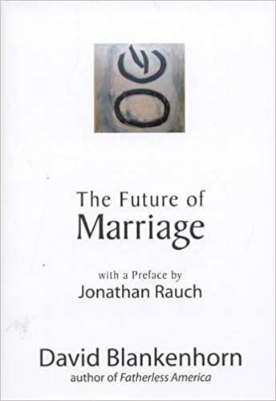

Slide 13
MARRIAGE
SEX
BABIES

Slide 15
Pre-Industrial Revolution
RESOURCES
COMMITMENT
SEX

Slide 16
Post-Industrial Revolution (1900)
RESOURCES
RESOURCES
COMMITMENT
SEX

Slide 17
Post-Pill (1960)
As the cost of sex for women (i.e., the risk of pregnancy) decreases, the supply of sex increases as its value decreases. In turn, the supply of male commitment decreases as its value increases.
RESOURCES
RESOURCES
COMMITMENT
SEX

Slide 18
Post-Internet (2000)
RESOURCES
RESOURCES
SEX
SEX
COMMITMENT
SEX

Slide 19
The result?
The “pure relationship” (i.e. confluent love)
Marriage is much rarer and later.
Men are less “marriageable.”
Women initiate divorce more.
Men are more reluctant to enter marriage; women are more reluctant to stay in marriage.
Pornography is at an all-time high.
Fertility is at an all-time low.

Slide 20
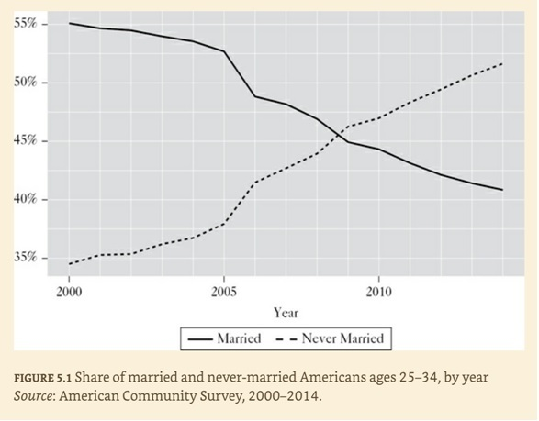

Slide 21
Eight predictions for 2030
Sex will get cheaper (and people will get lonelier).
Age of sexual consent laws will be less strictly enforced.
The rise in women’s average age at first marriage will slow/peak, but the share of unmarried Americans will keep rising.
Same-sex marriage will recede.
More straight men will dabble in homosexuality.
Polygamy may not become accepted, but polyamory likely will.
The church won’t be able to stem the retreat from marriage.
Efforts to de-gender society will fail.

Slide 22
MARRIAGE
SEX
BABIES

Slide 23
Evangelicals
opposed
this.
Evangelicals
went along
with this.
MARRIAGE
SEX
BABIES
This was made possible through
modern contraceptive technology.

Slide 24
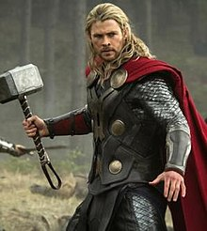

Slide 25
“We all craft individual lives for ourselves, each of us fulfilling distinct roles in this world. We are different members, performing different tasks. If you have children, I’m confident God will guide you in nurturing them to maturity with love. But if you are uninterested in having children, or unable to, there’s still a space for you in the church, and it’s not an identity that is ‘less than’ those who have kids…. If you have children, I celebrate with you. If you don’t but long for them, I mourn with you. If you desire marriage but don’t want kids, I understand, and I think God does too. There are many ways to have an impact on the world, to serve God and others. Having children is only one of them. We can’t all be Hawkeye, nor should we be.”
“We Can’t All Be Hawkeye”
Christ & Pop Culture (August 2018)

Slide 26
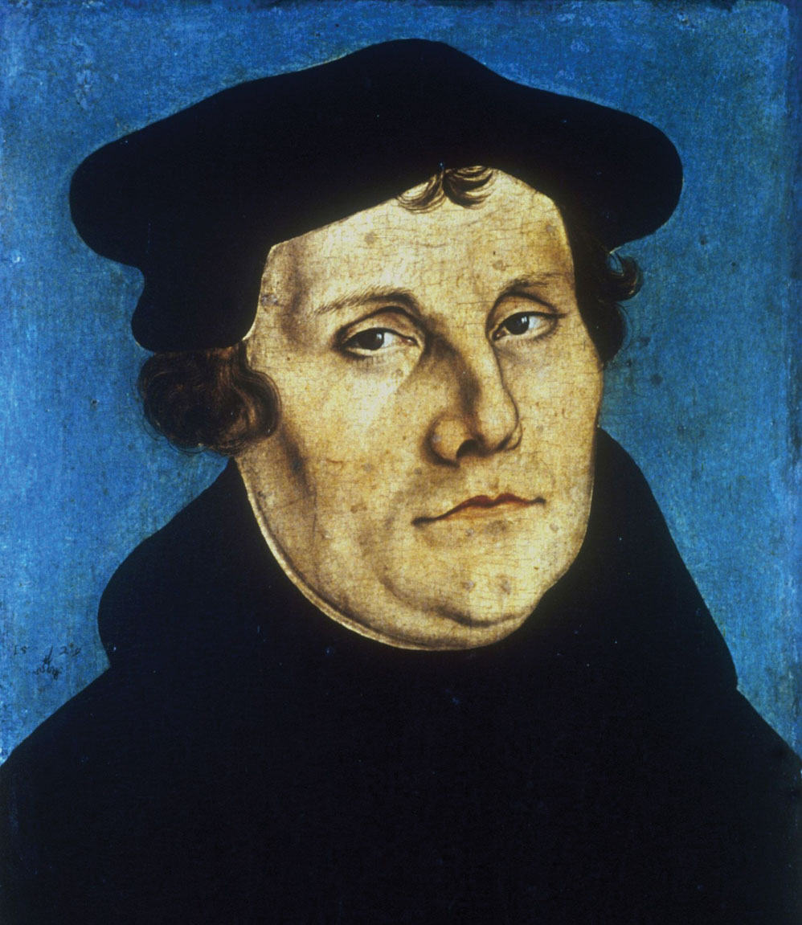
“God says in Genesis 2:18, ‘It is not good that the man be alone; I will make him an help who shall be about him’…. But he who would be a true Christian must grant that this saying of God is true, and believe that God was not drunk when He spoke the words and instituted marriage…. We were all created to do as our parents have done, to beget and rear children. This is a duty which God has laid upon us, commanded, and implanted in us, as is proved by our bodily members, our daily emotions, and the example of all mankind.”
—Martin Luther’s Open Letter to the Teutonic Knights

Slide 27
“How great, therefore, the wickedness of [fallen] human nature is! How many girls there are who prevent conception and kill and expel tender fetuses, although procreation is the work of God! Indeed, some spouses who marry and live together… have various ends in mind, but rarely children.”
—Martin Luther’s Commentary on Genesis 25

Slide 28
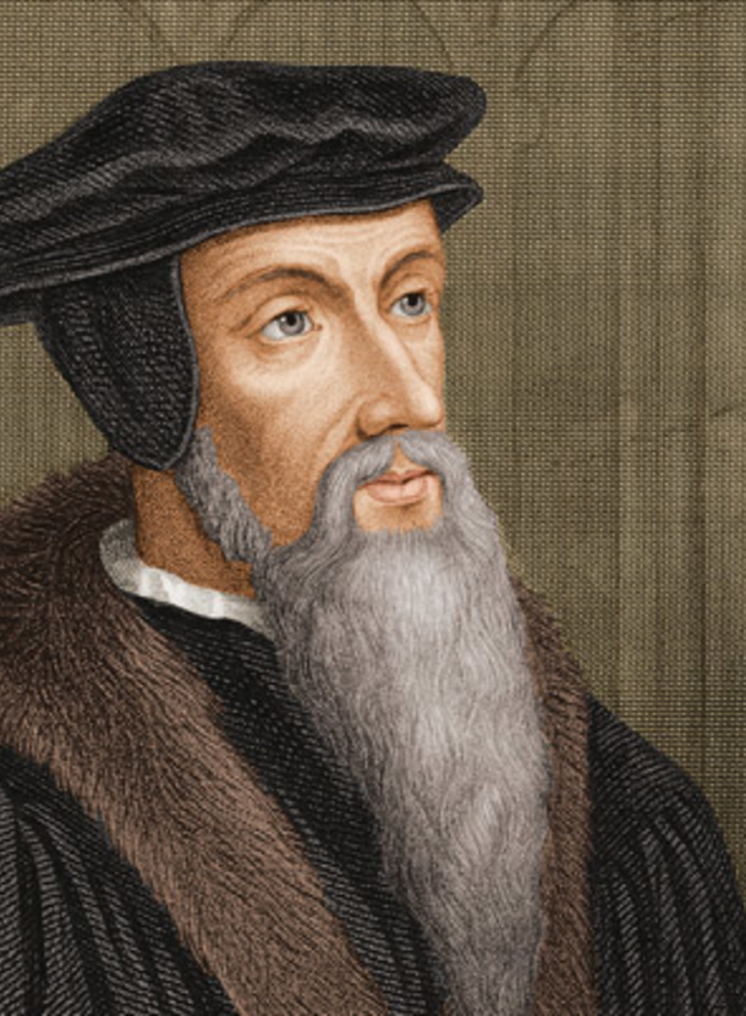
“[The sin of Onan] means that one quenches the hope of his family and kills the son, which could be expected, before he is born. This wickedness is now as severely as is possible condemned by the Spirit, through Moses, that Onan, as it were, through a violent and untimely birth, tore away the seed of his brother out the womb, and as cruel as shamefully has thrown on the earth. Moreover he thus has, as much as was in his power, tried to destroy a part of the human race. When a woman in some way drives away the seed out the womb, through aids, then this is rightly seen as an unforgivable crime. Onan was guilty of a similar crime.” —John Calvin, Commentary on Genesis 38

Slide 29
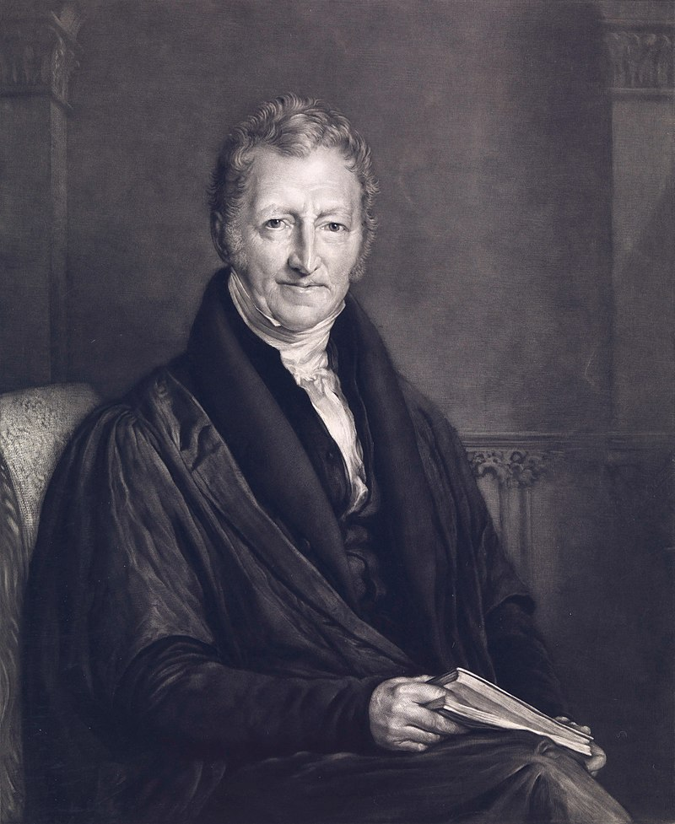
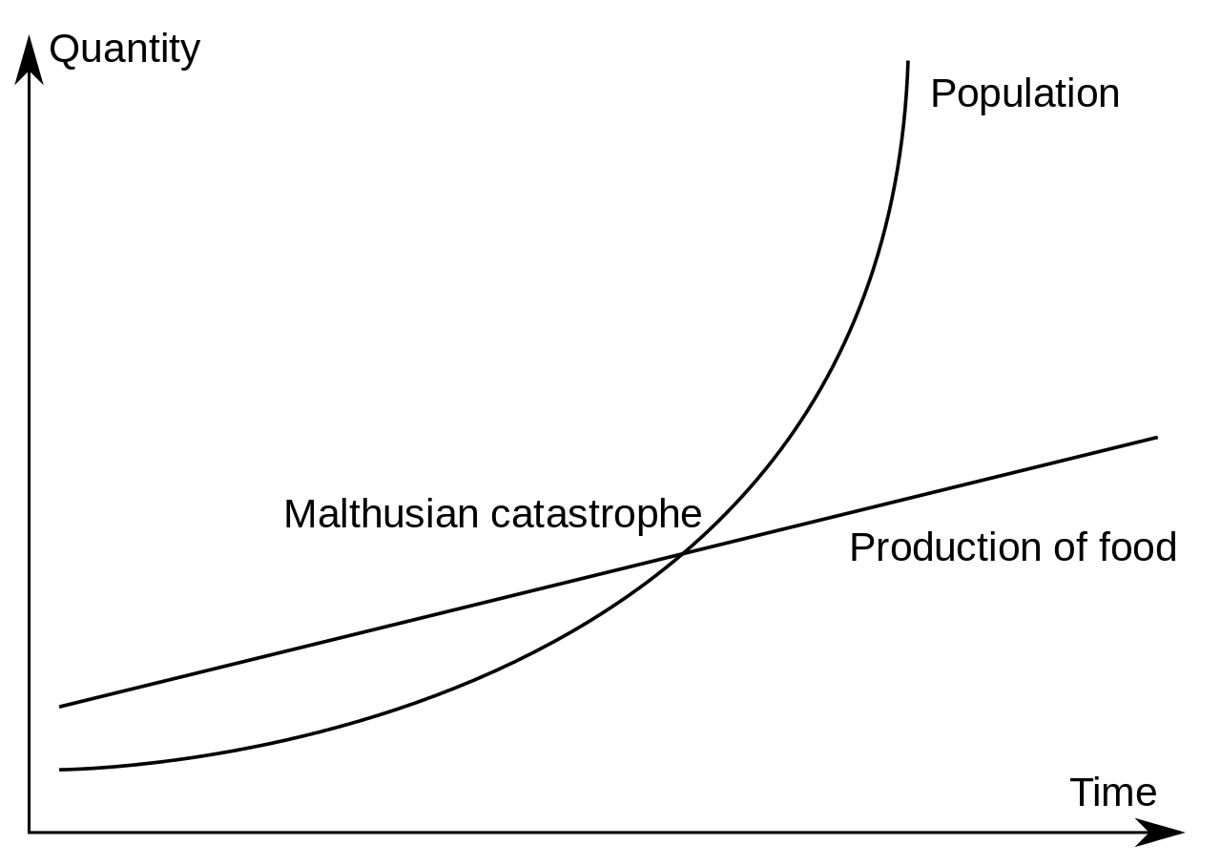
Thomas Robert Malthus
(1766-1834)

Slide 30
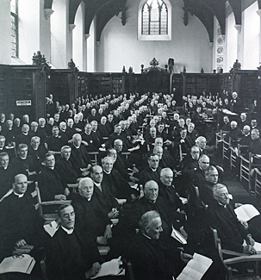
“In those cases where there is such a clearly felt moral obligation to limit or avoid parenthood, and where there is a morally sound reason for avoiding complete abstinence, other methods may be used, provided that this is done in the light of the same Christian principles.”
—1930 Lambeth Conference of the Anglican Communion

Slide 31
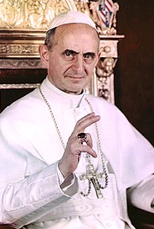
Humanae Vitae Pope Paul VI (1968)
Sexual intercourse is both unitive and procreative.
All artificial contraception is condemned.
Natural family planning (aka “the rhythm method”) is permitted.
Consequences of artificial contraception:
More marital infidelity
More objectification of women
More government intrusion

Slide 32
The biblical case for openness to procreation as the “default setting” for marriage
“Be fruitful and multiply” is a command, not an invitation (Gen. 1:28).
God’s purpose for marriage is “godly offspring” (Mal. 2:15).
Children are a blessing from the Lord (Psalm 127:3-5).
Onan, the only biblical example of intentional childlessness in marriage, is condemned for it (Gen. 38:8-10).
Paul calls homosexual relationships “unnatural” (Rom. 1:24-27). They are unnatural because they are inherently/structurally sterile.
An infertile straight couple is accidentally sterile, not inherently so.

Slide 33
Analogy from adoption
Ordinarily, a child has a right to his/her natural mother and father. This is the “default setting” for a child.
Therefore, a parent may not place their child in adoption merely for the sake of personal convenience.
However, in extreme circumstances (e.g., poverty, serious medical conditions, etc.), the parent may place their child in adoption.

Slide 34
Analogy from eating
Eating is for nourishment and for enjoyment.
Nourishment involves the coordination of both voluntary acts (chewing and swallowing) and involuntary acts (intestinal absorption of nutrients).
When the goal of nourishment is prevented involuntarily (such as through intestinal failure), this is lamentable but not immoral.
When the goal of nourishment is prevented voluntarily (such as in bulimia), eating becomes unnatural and immoral.

Slide 35
The ethical danger of hormonal birth control (aka “the Pill”)
Prevents ovulation, which in turn prevents an egg from being fertilized.
Thickens the mucus lining of the cervix, which in turn prevents sperm from reaching the egg.
Thins the endometrial lining of the uterus, which in turn prevents an already fertilized embryo from implanting, thus starving it to death. This is rare, but possible.

Slide 36
Objections to openness to procreation in marriage
“The Bible says to be fruitful and multiply, but we’ve already done that. Just look around! We can check that command off our checklist.”
“Having kids puts a strain on the earth’s resources.”
“Having kids will increase our carbon footprint and cause damage to the environment.”
“Not all married couples are cut out to have kids.”

Slide 37
Resources
“Moms Don’t Dad and Dads Don’t Mom,” BreakPoint Podcast (November 25, 2020)
Allan Carlson, “Children of the Reformation: A Short & Surprising History of Protestantism & Contraception,” Touchstone: A Journal of Mere Christianity (May 2007)
“The Economics of Sex,” by The Austin Institute (YouTube video)
“Protestants and Contraception,” by Evan Lenow, First Things (January 2018)

Slide 38
The natural law response: two views of marriage
The conjugal view
The revisionist view
A union of body and mind
Consummated by coitus
Ordered toward procreation
Permanent and exclusive
Centered on children’s needs
State recognition serves family stability and healthy citizenry
An emotional/romantic union
Enhanced by sexual activity
Child-rearing is optional
Permanence/exclusivity optional
Centered on adults’ rights
State recognition serves social affirmation

Slide 39
MARRIAGE LEAGUE BASEBALL
Team Fertile plays to win. They practice regularly and play by the rules, and sometimes it pays off. Their fans love them and cheer every time they win.
Team Infertile also plays to win. They practice regularly and play by the rules, but never manage to win. Their fans love them and mourn every loss.
Team Intentionally Childless doesn’t play to win. They show up to the games and wear the uniforms, but they have no interest in scoring runs. They don’t have any fans.
Team Gay shows up to the games wearing hockey gear. They play by the rules of hockey rather than baseball, but they insist that everyone calls them a baseball team. The other teams’ fans want them ejected from the league.

Slide 40
Technology
(The pill, the internet, etc.)
Media
(Hollywood, Big Tech, etc.)
THE SEXUAL
REVOLUTION
Politics
(Roe v. Wade, Obergefell, etc.)
Philosophy
(Freud, Post-modernism, etc.)

Slide 41
Christians’ responses to gay marriage
The accommodationist response: “Gay marriage is wrong biblically and morally, but it should still be tolerated legally.”
The libertarian response: “Get the government out of marriage entirely, and let it be a private institution.”
The theonomist response: “Outlaw gay marriage because it goes against Scripture. Society should conform to a biblical worldview.”
The natural law response: “Outlaw gay marriage because it undermines the objectively recognizable social goods that are achieved by real marriage.”

Slide 42
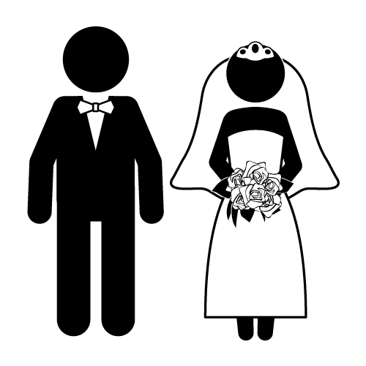
Why should marriage be only
between a man and a woman?
Reflection of Christ and the Church
Complementarity of man and woman
Ordered toward procreation and child-rearing

Slide 43
Why should the state recognize marriage only between a man and a woman?
Reflection of Christ and the Church
This is knowable only through Scripture, and it will have little persuasive force with non-Christians who don’t share biblical presuppositions.
This would probably run afoul of the First Amendment, which forbids laws that hinder the free exercise of religion.
Theologically, it’s questionable whether this principle is more foundational than procreation, since procreation existed before the Fall, but Christ’s Incarnation and the Church did not.

Slide 44
Why should the state recognize marriage only between a man and a woman?
Complementarity of man and woman
This is knowable through general revelation: men and women are fit for each other!
Conjugal marriage encourages men to settle down, and it makes women more secure. But gay marriage does neither.
Married gay men tend to favor open/promiscuous arrangements.
Married lesbians tend to divorce at much higher rates.
Does the denial of this principle lead to demonstrable harm to society that warrants state intervention?

Slide 45
Why should the state recognize marriage only between a man and a woman?
Must be a permanent union
Must be a sexual union
Must be unrelated
Must be only two people
Must be legally protected
Ordered toward procreation and child-rearing

Slide 46
Why rule out temporary relationships?
Why rule out platonic relationships?
Must be a permanent union?
Why rule out incestuous relationships?
Must be a sexual union?
Must be unrelated?
Must be only two people?
Must be legally protected?
Why rule out polyamorous/open relationships?
Friendships don’t need legal protection; why should marriage?
Ordered toward emotional fulfillment

Slide 47
New Family Structures Study (NFSS): Children raised in same-sex homes are more likely to…
Experience poor educational attainment
Report overall lower levels of happiness, mental and physical health.
Have impulsive behavior
Be in counseling or mental health therapy (2x)
Suffer from depression (by large margins)
Have recently thought of suicide (significantly)
Identify as bisexual, lesbian or gay
Be unemployed or part-time employed as young adults
As adults, currently be on public assistance or sometime in their childhood
Live in homes with lower income levels
Drink with intention of getting drunk
To smoke tobacco and marijuana
Spend more time watching TV
Have frequency of arrests
Have pled guilty to minor legal offense
“Key Findings of Mark Regnerus’ New Family Structures Study”
Glenn Stanton, Focus on the Family (October 2012)

Slide 48
Answering the critics of NFSS
Studies that have attempted to prove equal or better outcomes for children raised in same-sex homes fall short due to:
Nonrandom selection of participants
Small sample size
Results based on self-reporting of parents, not of children
“The Campaign to Discredit Regnerus and the Assault on Peer Review”
Peter Wood, National Association of Scholars (Summer 2013)

Slide 49
The equality objection: “Everyone deserves equal rights before the law; therefore, gay marriages deserve equal legal recognition.”
Are gay marriage proponents willing to extend equal rights to polygamous marriages, incestuous marriages, underage marriages, etc.?
Do gay marriages achieve the same social goods as conjugal marriages?

Slide 50
Hey, that’s discrimination!
$$$
Scholarships, grants,
tax credits, etc.
Non-students
Students

Slide 51
The adoption objection: “Gay couples can adopt; therefore, they should still be allowed to marry.”
An ability to adopt doesn’t automatically entail a right to marry. What if two siblings wanted to adopt? Does that give them a right to marry?
Just because they can adopt, that doesn’t mean it’s good for the children.
Even if a gay couple were excellent parents, that doesn’t mean children don’t normally have a right to a biological mother and father.

Slide 52
The bigotry objection: “Opposition to gay marriage can only be motivated by bigotry.”
It’s possible to oppose gay marriage even if one doesn’t think there’s anything morally wrong with homosexual behavior.
Christians will still be considered bigots even if they tolerate legalized gay marriage.
Ask the question, “What do you mean by the word ‘bigot’?”

Slide 54
The “conservative” objection: “If marriage is good for society (promoting stability, commitment, etc.), then it’s good for gay couples too.”
Gay marriage proponents (usually) don’t want the norms that go along with marriage; they only want the public affirmation.
Gay marriage can mimic marital norms, but they cannot rationally justify them. Only procreation and child-rearing provide an objectively knowable justification for such norms as exclusivity and permanence. Without such rational justification, the norms will erode over time.

Slide 55
The cruelty objection: “Opposing gay marriage is cruel, because it denies the practical needs of gay couples, causes dignitary harm, and deprives them of personal fulfillment.”
Practical needs (hospital visitation rights, inheritance rights, etc.) can be met through sex-neutral civil unions, without redefining marriage.
Is there any dignitary harm in denying marriage to siblings, polyamorous relationships, etc.?
Why would legal recognition be necessary for personal fulfillment? For example, do friendships need legal recognition for their fulfillment?

Slide 56
The libertarian objection: “The government should just get out of marriage altogether.”
“Sex makes babies, society needs babies, and children need mothers and fathers.” (Maggie Gallagher, National Organization for Marriage)
What’s legal is perceived as normal, and what’s normal is perceived as good.
Legislating marriage is unavoidable, since the state will have to intervene when marriages break down (divorce, custody, alimony, property, welfare, incarceration, etc.).

Slide 57
The libertarian objection: “The government should just get out of marriage altogether.”
When does something warrant state involvement?
When it serves an important social good
When people have a right to it
When private groups cannot secure it well
When everyone suffers if it is lost
When the state can secure it without undue cost

Slide 58
