Slide 1
Cults & Heresies
Introduction

Slide 2
Introduction
Why this class?
How would you define “cult”?
How would you define “heresy”?

Slide 3
“I hope no reader will suppose that ‘mere’ Christianity is here put forward as an alternative to the creeds of the existing communions — as if a man could adopt it in preference to Congregationalism [like Baptists] or Greek Orthodoxy or anything else. It is more like a hall out of which doors open into several rooms. If I can bring anyone into that hall, I have done what I attempted. But it is in the rooms, not the hall, that there are fires and chairs and meals. The hall is a place to wait in, a place from which to try the various doors, not a place to live in. For that purpose the worst of the rooms (whichever that may be) is, I think preferable. It is true that some people may find they have to wait in the hall for a considerable time, while others feel certain almost at once which door they must knock at. I do not know why there is this difference, but I am sure God keeps no one waiting unless He sees that it is good for him to wait. When you do get into the room you will find that the long wait has done some kind of good which you would not have had otherwise. But you must regard it as waiting, not as camping. You must keep on praying for light: and, of course, even in the hall, you must begin trying to obey the rules which are common to the whole house. And above all you must be asking which door is the true one; not which pleases you best by its paint and paneling.”
—C.S. Lewis, Mere Christianity

Slide 4
“Mere” Christianity
Baptists
Presbyterian
Atheists
Lutherans
Reformed
Nicene Creed
Buddhists
Apostles’ Creed
Methodists
Non-Denom
Hindus
Anglicans
Pentecostal
Muslims
Heresy

Slide 5
“Heresy” in Scripture
“But false prophets also arose among the people, just as there will be false teachers among you, who will secretly bring in destructive heresies (Greek hairesis), even denying the Master who bought them, bringing upon themselves swift destruction.” (2 Peter 2:1)
“Children, it is the last hour, and as you have heard that antichrist is coming, so now many antichrists have come. Therefore we know that it is the last hour. They went out from us, but they were not of us; for if they had been of us, they would have continued with us. But they went out, that it might become plain that they all are not of us.” (1 John 2:18-19)

Slide 6
Degrees of truth and error
 | ORTHODOXY | OPINION (ADIAPHORA) | ERROR | HETERODOXY | HERESY
Definition | What the Bible clearly teaches; what Christians must believe | Where the Bible leaves room for different interpretations | Mistakes that don’t affect the rest of your theology | Mistakes that affect your theology, but still Christian | False teachings made by those who claim to be Christians
Example | Resurrection of Jesus | Robes for pastors | Number of Solomon's horses | Predestination vs. free will | Mormonism
NOT
CHRISTIAN
CHRISTIAN

Slide 7
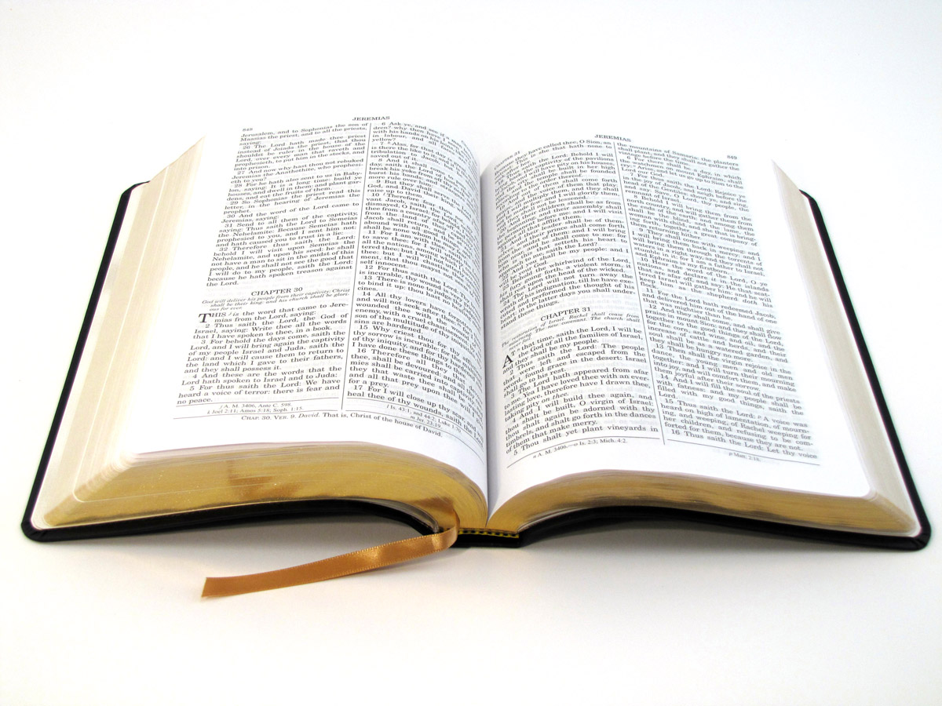
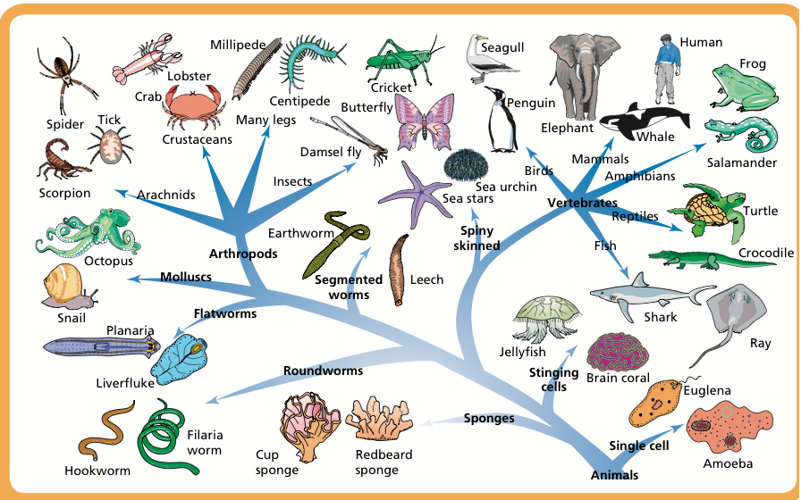
CLARITY
How clearly is it
taught in the Bible?
CATHOLICITY
Has it always been
taught in the church?
CATEGORY
What type of
doctrine is it?
CONSEQUENCE
What are its practical
effects in the church?

Slide 8
Category: what type of doctrine is it?
Category | Theology Proper | Christology | Anthropology | Soteriology | Ecclesiology
Examples | Monotheism, Trinity | Crucifixion, Resurrection | Image of God, Original Sin | Justification, Sanctification | Sacraments, Government
Sects or denominations | Christians vs. Mormons/JW’s | Evangelicals vs. Liberals | West vs. East | Calvinists vs. Arminians | Baptists vs. Presbyterians
Apostles’ Creed – Nicaea – Chalcedon – Reformation – Westminster

Slide 9
What is a cult?
False teaching
CULT
Manipulative/
authoritarian
Counter-cultural

Slide 10
Heresy or cult?
Heresy
Cult
Mormons
False teaching
by those
who
claim to
be Christian
Liberal
Protestantism
Scientology
Countercultural
and
authoritarian/
manipulative
leadership
Jehovah’s
Witnesses
Asatru
(Neo-Paganism)
Prosperity
Gospel
Christian
Science

Slide 11
Overview of the class
Mormonism
Jehovah’s Witnesses
Christian Science
Scientology
Prosperity Gospel/Word of Faith
United Pentecostal Church
…Any others?

